Slide 1
Decision Tree

Slide 2
Supervised Learning
Example problem: Restaurant waiting
the problem of deciding whether to wait for a table at a restaurant.
For this problem the output, y, is a Boolean variable that we will call WillWait.
The input, x, is a vector of ten attribute values, each of which has discrete values:
Alternate: whether there is a suitable alternative restaurant nearby.
Bar: whether the restaurant has a comfortable bar area to wait in.
Fri/Sat: true on Fridays and Saturdays.
Hungry: whether we are hungry right now.
Patrons: how many people are in the restaurant (values are None, Some, and Full).
Price: the restaurant’s price range ($, $$, $$$).
Raining: whether it is raining outside.
Reservation: whether we made a reservation.
Type: the kind of restaurant (French, Italian, Thai, or burger).
WaitEstimate: host’s wait estimate: 0–10, 10–30, 30–60, or >60minutes

Slide 3
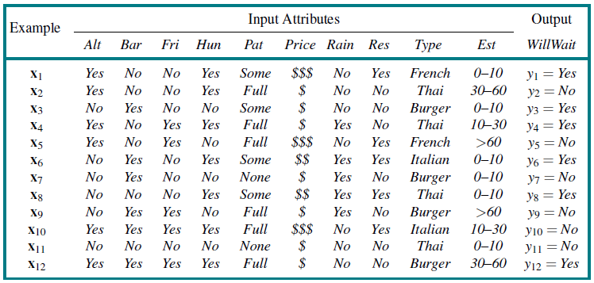
Supervised Learning
Examples for the restaurant domain.

Slide 4
Decision Trees
A decision tree is a representation of a function that maps a vector of attribute values to a single output value—a “decision.”
reaches its decision by performing a sequence of tests, starting at the root and following the appropriate branch until a leaf is reached.
each internal node in the tree corresponds to a test of the value of one of the input attributes
the branches from the node are labeled with the possible values of the attribute,
the leaf nodes specify what value is to be returned by the function.
Boolean decision tree is equivalent to a logical statement of the form:
Output ⇔ (Path₁ ∨ Path₂ ∨···)

Slide 5
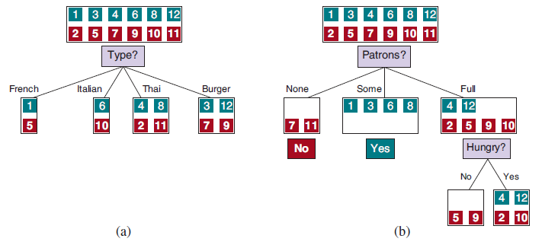
Decision Trees
Splitting the examples by testing on attributes. At each node we show the positive (light boxes) and negative (dark boxes) examples remaining.
Splitting on Type brings us no nearer to distinguishing between positive and negative examples.
Splitting on Patrons does a good job of separating positive and negative examples. After splitting on Patrons, Hungry is a fairly good second test

Slide 6
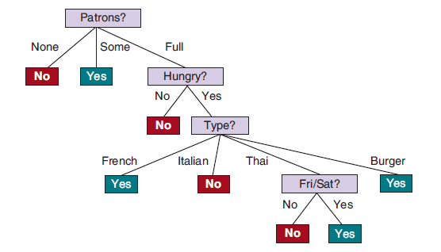
Decision Trees
The decision tree induced from the 12-example training set.

Slide 7

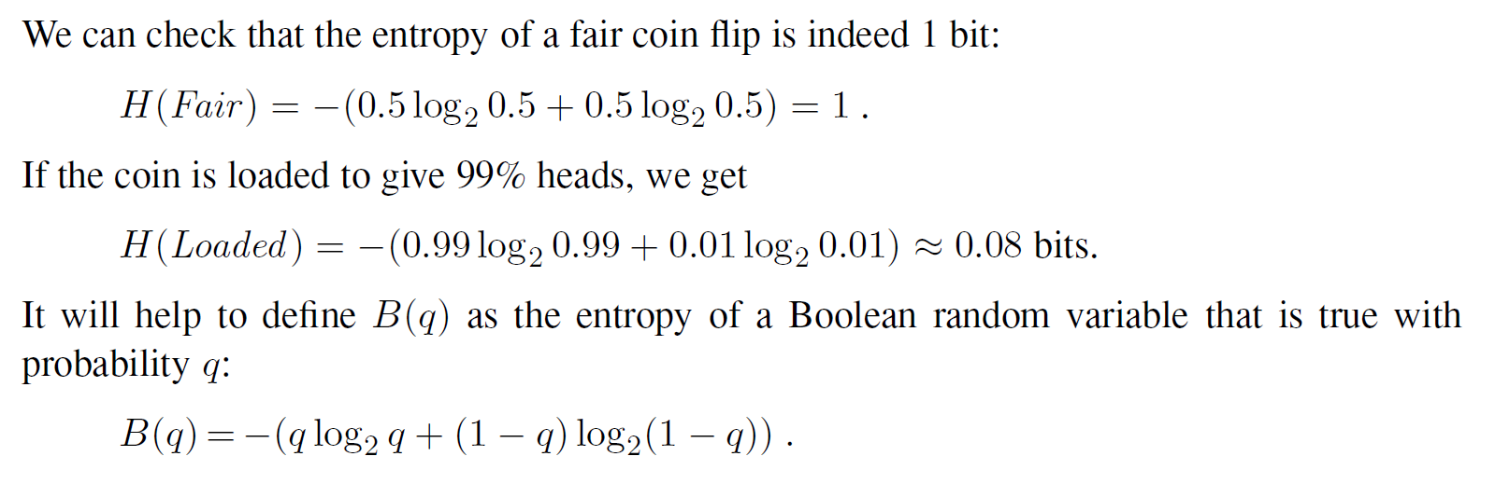
Decision Trees
Choosing attribute tests
Entropy: measure of the uncertainty of a random variable;
the more information, the less entropy
fundamental quantity in information theory
In general, the entropy of a random variable V with values v_{k} having probability

Slide 8
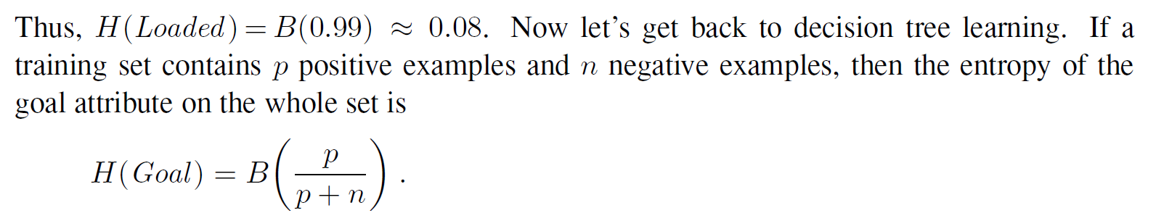
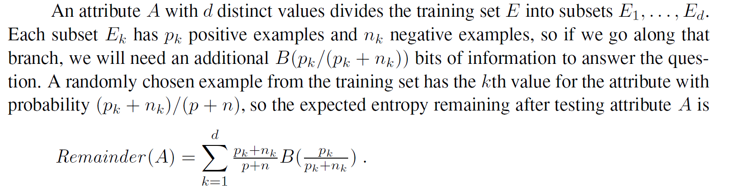
Decision Trees
Choosing attribute tests

Slide 9
Decision Trees
Splitting the examples by testing on attributes. At each node we show the positive (light boxes) and negative (dark boxes) examples remaining.
Splitting on Type brings us no nearer to distinguishing between positive and negative examples.
Splitting on Patrons does a good job of separating positive and negative examples. After splitting on Patrons, Hungry is a fairly good second test

Slide 10

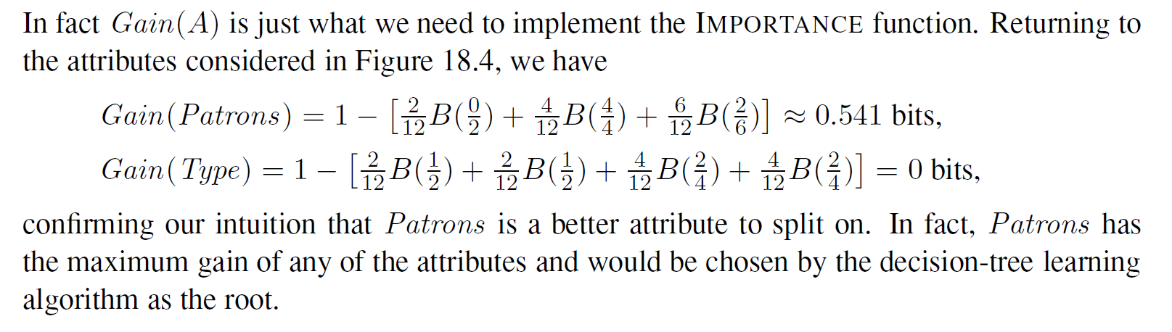
Decision Trees
Choosing attribute tests
The information gain from the attribute test on A is the expected reduction in entropy:

Slide 11


Decision Trees
Decision tree pruning helps combat overfitting
Eliminating nodes that are not clearly relevant
How large a gain should we require in order to split on a particular attribute?
Significance test
Start with null hypothesis
Calculate extent data deviates from perfect absence of pattern
degree of deviation is statistically unlikely (<=5% probability)
node consisting of p positive and n negative examples. expected numbers, pˆ_{k} and nˆ_{k},
Measure deviation & total deviation

Slide 12
Decision Trees
Broadening the applicability of decision trees
Decision trees can be made more widely useful by handling the following complications:
Missing data
Continuous and multivalued input attributes
Continuous-valued output attribute
Decision trees are also unstable in that adding just one new example can change the test at the root, which changes the entire tree

